Slide 1
Revelation 4 - 5

Slide 2
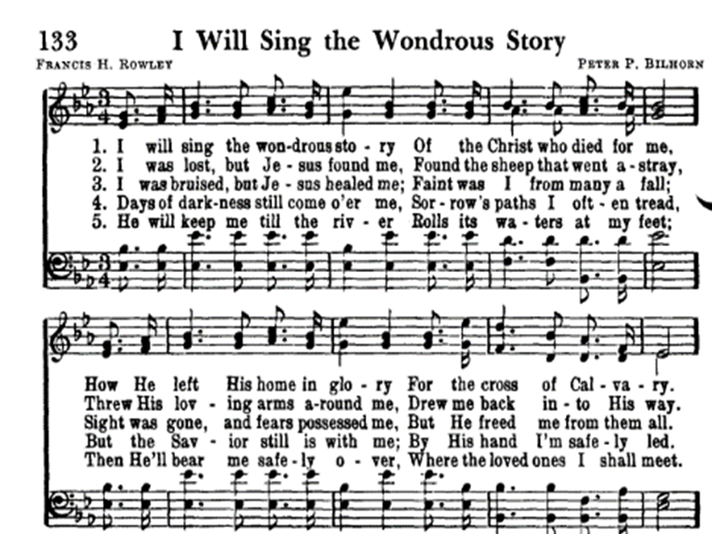
Revelation 4:6
⁶ And before the throne there was a sea of glass like unto crystal: and in the midst of the throne, and round about the throne, were four beasts full of eyes before and behind.
Notes:
In Revelation, “crystal” is not a proper noun, it is an adjective.
Rev 21:10-11
“crystal”: Describes new Jerusalem descending from out of Heaven shining as a precious stone clear as crystal
Rev 22:1
“crystal”: Describes River of Life flowing clear as crystal
Rev 4:6
“crystal”: Describes a sea of glass clear as crystal
“Poetic License”
Allows me to say “Jesus is the Rose of Sharon”
Does NOT allow me to make a factually inaccurate statement

Slide 3
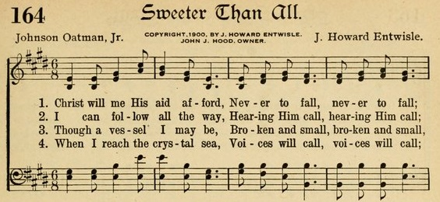
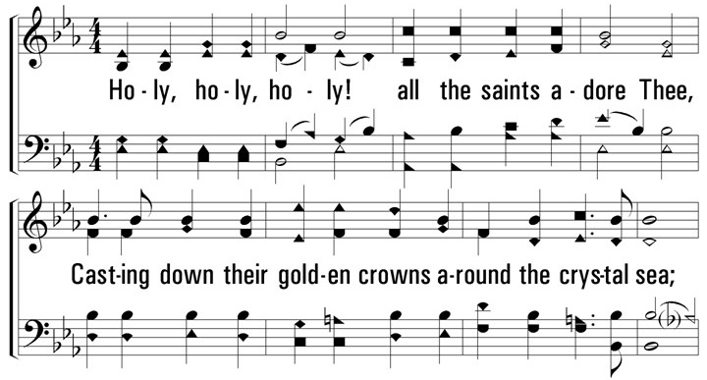
Revelation 4:6 - “Crystal Sea”
“Victory in Jesus”
3 - I heard about a mansion he has built for me in glory,
And I heard about the streets of gold beyond the crystal sea;
About the angels singing and the old redemption story,
And some sweet day I’ll sing up there the song of victory.

Slide 4
Revelation 5:1 - Punctuation
Just Be Aware!
Luke 23:43 (RSV , NASB , NKJV) ⁴³ “I say to you, today you will be with me in paradise.”
Luke 23:43 (New World Translation) ⁴³ “Truly I tell you today, you will be with me in paradise.”
Punctuation left to discretion of translator
Instances studied in depth – no doctrinal impact

Slide 5
Revelation 5:1
Revelation 5:1 (KJV ) ¹ And I saw in the right hand of him that sat on the throne a book written within and on the backside, sealed with seven seals.
Revelation 5:1 (NKJV) ¹ And I saw in the right hand of Him who sat on the throne a scroll written inside and on the back, sealed with seven seals.
Revelation 5:1 (NRSV footnote) ¹ “written on the inside, and sealed on the back with seven seals.”
Revelation 5:1 (Haweis N.T.) ¹ “written within, and on the back sealed with seven seals.”
Notes:
Punctuation:
No commas
Sometimes, punctuation changes the meaning
In this case, it is benign
Probably sealed on the backside with 7 seals.
Adds nothing to discussion to say that the scroll was written on the backside

Slide 6
Revelation 5:1
¹ And I saw in the right hand of Him that sat on the throne a book ¹ written within and on the backside, sealed with seven seals.
Βιβλίον (biblion) – Ref #975 ¹
18x in N.T.
Literal: “papyrus scroll” ¹
Small book
Scroll
Writing
Certificate
Bill
Document
Translations
26 - “book” ¹
24 - “scroll” ¹
¹ biblehub.com
Notes:
biblion
Scroll or book is fine. Probably a scroll
End of 1st century, Roman empire used “codex”
Stacked paper bound in form of a book
Eventually, Gr. word used as “book”
https://web.stanford.edu/class/complit172c/8jan.html
The diminutive of biblos in Greek was biblion -- 'little scroll'. It lost its diminutive note and was used to mean any book (all books were in scroll form then). Biblia was used in Greek to refer to the scriptures from the 2nd c. BC onward. Biblia was plural, and our Bible was considered an anthology of books, rather than just one, until the early centuries AD.

Slide 7
Revelation 5:2
² And I saw a strong angel proclaiming with a loud voice, Who is worthy to open the book, and to loose the seals thereof?
ἄξιος (axios) – Ref #514 ¹
41x in N.T. (4x in Rev)
Derived from aksō: ¹
To weigh
How comparably something weighs in
Worthy of
Deserving
Comparable
Suitable
Assigning matching weight values on scales
¹ biblehub.com
Notes:
English word “worthy” does not do this Greek word justice.
What does loosening seals accomplish?
What does opening scroll accomplish?

Slide 8
Revelation 5:1-3
¹ And I saw in the right hand of Him that sat on the throne a book written within and on the backside, sealed with seven seals.
² And I saw a strong angel proclaiming with a loud voice, Who is worthy to open the book, and to loose the seals thereof?
³ And no man [one] [none] in heaven, nor in earth, neither under the earth, was able to open the book, neither to look thereon.
No one “equal to the task” to open the scroll
God not “worthy”?
Notes:
God not being “worthy” to open the scroll is so non-intuitive.
Revelation will tell us later why Jesus is worthy.
Be patient and let Revelation answer our questions

Slide 9
Revelation 5:4
⁴ And I wept much, because no man was found worthy to open and to read the book, neither to look thereon.
Trick Question: Why did John weep?
Can’t answer without knowing purpose of scroll
Notes:
Some enjoy pontificating / wax eloquently on this question. But they are still only guessing.
Guessing isn’t good enough when discussing Revelation.
Some guess scroll = gospel
No one worthy to open gospel and preach it
Therefore, John wept
When Revelation means “gospel”, it uses the word “gospel”. Rev 14:6

Slide 10
Revelation 5:1-12
Questions
What is the purpose of a scroll with 7 seals?
What does loosing seals accomplish?
What does opening scroll accomplish?
Why is God not worthy to open the book?
How did Jesus prevail?
Why did John weep?
To what is Jesus “heir”?
Notes:
At this point, these questions cannot be answered, and if answered, their answer is a guess and cannot be proven. Why?
Because Revelation has not given us the answer . . . . Yet.
In most cases, if we wait, the “Forbidden Zone” will answer our questions for us.
We don’t have to guess!
Similar questions that are answered by “Forbidden Zone”
Why do Christians suffer?
What is the Tribulation?
The “Forbidden Zone” contains the answers

Slide 11
Revelation 5
1. What is the purpose of a scroll with 7 seals?
Gaius 2.147 (130-180 AD)
Roman law expert and commentator
Under Roman Law, Last Will and Testament
In scroll form for “common” people
Required 5 witnesses, 7 seals
1 heir, 1 executor/executrix, 5 witnesses
At reading, each witness removed their seal
7 churches of Asia understood symbology
Scroll represents resolution to a situation
Legal writing, certificate, bill, document
Notes:
1) What is the purpose of a scroll with 7 seals?
Gaius 2.147 (130-180 AD):
Roman law expert and commentator
Under Roman law, the common person’s Last Will and Testament:
In scroll form
Required 7 witnesses
Heir, Executor, 5 Witnesses
Each witness had a seal that sealed the document
At reading of will, each witness or representative would remove their seal
Verified document had not been tampered with
Being common people, clearly John and 7 churches would understand the symbology
“Small book, scroll containing legal writing, certificate, bill, document”

Slide 12
Revelation 5
2. What does loosing seals accomplish?
Seal verify legal contents not tampered with
Content remains legitimate & legal
Technically, we do not know until Ch. 8-9
When a seal is loosed
Villain is judged
Villain is punished
Or, both
Gives villain opportunity to repent (Ch. 9:20)
Notes:
2) What does loosing seals accomplish?
Technically, we don’t know purpose of seals until chapters 8 & 9
Every time a seal is broken:
Villain is judged
Villain is punished
Or, both

Slide 13
Revelation 5
3. What does opening scroll accomplish?
Final will, legality, and judgment against villain
(after all seals removed)
Technically, we are not told until Ch. 16
Final reading and judgment is performed
Symbolically represented by Armageddon
Notes:
3) What does opening book accomplish?
In Chapter 16, when all seals are removed
Specifically, final judgment is passed on villain of Revelation
Generally, judgment against evil
Symbolically represented by Armageddon
Not clear, yet, but will be clear by Chapter 16

Slide 14
Revelation 5
4. Why is God not worthy to open the scroll?
Hebrews 1:2
God selected the Lamb to be heir of all things
Revelation explains “heir of all things”
Because Jesus is the one who “prevailed”
Notes:
Hebrews 1:2
Hath in these last days spoken unto us by his Son, whom he hath appointed heir of all things, by whom also he made the worlds;

Slide 15
Revelation 5:9-10
5. How did Jesus prevail?
⁹ And they sung a new song, saying, You are worthy to take the book, and to open the seals thereof: for you were slain, and has redeemed us to God by your blood out of every kindred, and tongue, and people, and nation;
¹⁰ And has made us unto our God kings and priests: and we shall reign on the earth.
The Lamb is worthy
Was slain and defeated death
Redeemed us to God with his blood
Made us kings and priests to God
Notes:
Blood of the Lamb is accepted or rejected
Jesus inherited right to judge
Reign on earth? “1000 Year Reign”?
Best commentary on the book of Revelation is the Bible itself.
Ephesians 6:12 - “For we wrestle not against flesh and blood, but against principalities, against powers, against the rulers of the darkness of this world, against spiritual wickedness in high places.”
Romans 8:37-39 - . . . in all these things we are more than conquerors through him that loved us. 38 For I am persuaded, that neither death, nor life, nor angels, nor principalities, nor powers, nor things present, nor things to come, 39 Nor height, nor depth, nor any other creature, shall be able to separate us from the love of God, which is in Christ Jesus our Lord.
Romans 8:17 - We are “co-heirs” or “joint-heirs” with Jesus.

Slide 16
Revelation 5
6. Why did John weep?
⁴ And I wept much, because no man was found worthy to open and to read the book, neither to look thereon.
Scroll, legal writing, certificate, bill, document
Sealed scrolls contain a:
Resolution; legal judgment; solution to situation
John inspired to know meaning of scroll?
Understand because Roman culture
Some claim it is the Gospel?
Sealed so world would not know how to be saved?
Notes:
No one worthy to open seal means no resolution
John weeping shows just how desperate the Christians were to getting a resolution to the persecution.
Some say it is the Gospel sealed so world would not know how to be saved.
Contradicts chapter 9 – God tries to get villain to repent
When Revelation means “gospel”, it uses the word “gospel”. Rev 14:6

Slide 17
Revelation 5:12
7. To what is Jesus “heir”?
¹² Saying with a loud voice, Worthy is the Lamb that was slain to receive power, and riches, and wisdom, and strength, and honour, and glory, and blessing.
Jesus heir to all things including right to judge
His blood is what is accepted or rejected
Notes:
Hebrews 1:2
Hath in these last days spoken unto us by his Son, whom he hath appointed heir of all things, by whom also he made the worlds;
Right to judge: His body, His blood, His sacrifice that is being accepted or rejected

Slide 18
Revelation 5:5
⁵ And one of the elders saith unto me, Weep not: behold, the Lion of the tribe of Judah, the Root of David, has prevailed ¹ to open the book, and to loose the seven seals thereof.
ἐνίκησεν (enikēsen) – Ref #3528 ¹
1x in N.T.
conquer, victorious, overcome, prevail, subdue
17 variations used in Revelation
¹ biblehub.com (Strong’s Concordance) ἐνίκησεν (enikēsen)
conquer, victorious, overcome, prevail, subdue. 17 variations used in Revelation
Notes:
Why is Jesus worthy to open scroll?
Prevailed? How?
Answer coming . . .
Give Revelation enough time, and most of our questions will be answered.

Slide 19
Revelation 5:11
¹¹ And I beheld, and I heard the voice of many angels round about the throne and the beasts and the elders: and the number of them was ten thousand times ten thousand [Gr. myriads of myriads ¹], and thousands of thousands;
Μυριάς - “Myriad” ¹
Modern Greek: Hundred million
Figurative: “indefinitely large number”
Heaven’s population is indefinitely large
(999,999,999² + 999,999²⁾
1,000,000,997,998,000,000
¹ Biblehub.com – μυριάδες μυριάδων (myriads of myriads)
Notes:
Myriad: Modern Greek = hundred million
“myriads of myriads”: (999 million x 999 million) + (999 thousand x 999 thousand) = 1 followed by 18 zeros
Psalm 8:4
4 “What is man that You are mindful of him, And the son of man that You visit him?”

